Slide 1
Welcome to Year 6 Reading

Slide 2
Welcome to Year 6
Thank you for coming to our workshop!
Please sit with your child
If you have any questions during the workshop, we can come and help you

Slide 3
Reading Homework Expectations
A book a half term – 6 over the year.
a variety of different genres to broaden language and experiences.
10-15 pages (for 5 nights at least) , depending on the level of the book and these pages recorded in the homework diary Bookworm page.
At the end of your book (over half term or the end of term) write a short summary/Book Review of the key events.
If you do not finish the book during school time you will be given half term to catch up.

Slide 4
Holiday Reading – A Book Review

Slide 5
Homework diary entries The Bookworm page.
You should write something about what you have read each night. These can be a variety of different things.
Vocabulary : words and – pick a word from what you have read and explain what it means, by context and dictionary definition.
A question/puzzle– write a question, then write a possible answer.
Connection with something else – what links to other books, films, real life events does it have?
Author’s technique – What effect does it have on the reader.

Slide 6
Vocabulary
Comment or idea
Author’s technique
Vocabulary
Connection
Notes:
Project on screen while pupils on task

Slide 7
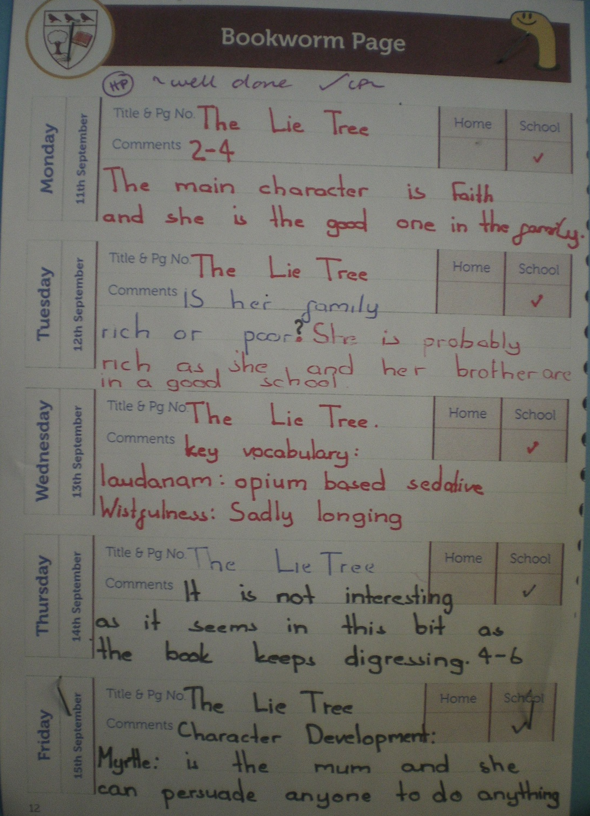
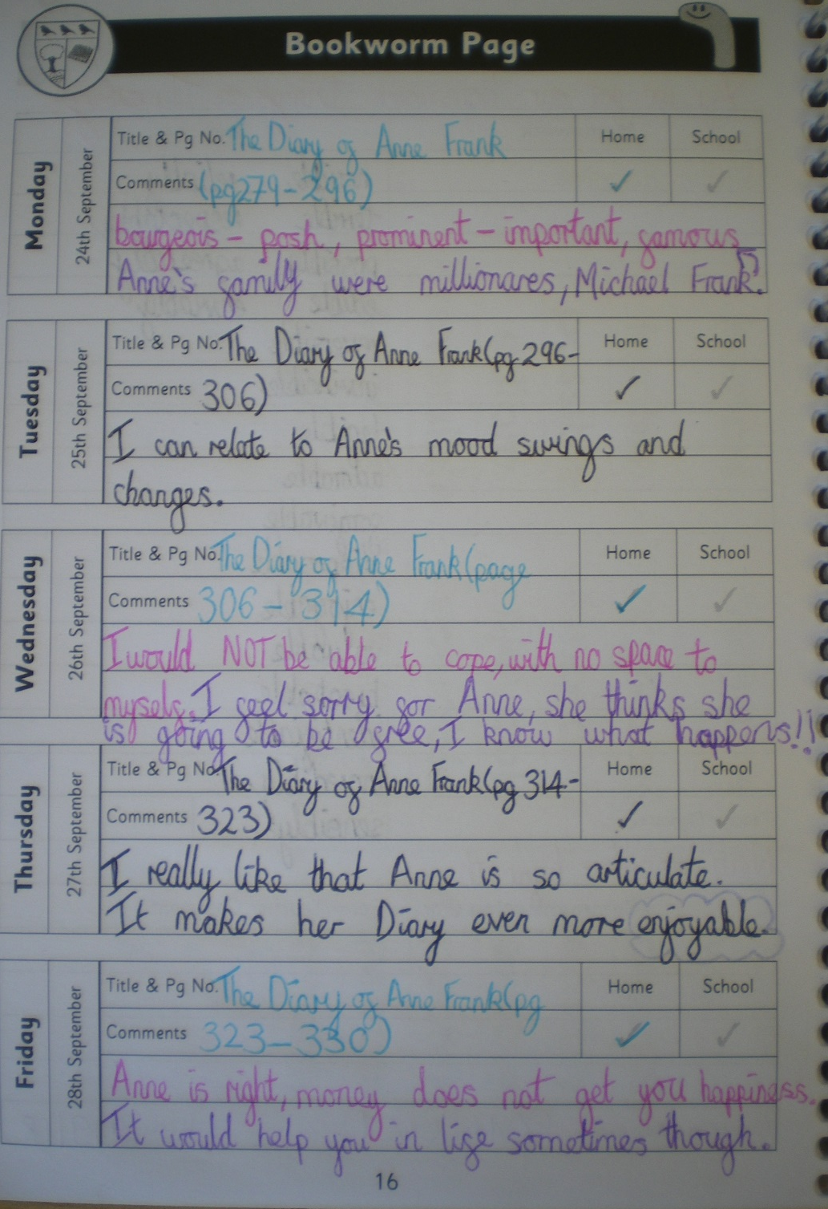

Slide 8
We have been taught how to write these Book worm page comments in class while making notes while listening to our class text: Wolf Brother

Slide 9
Reading Comprehension task
Use your current reading book to fill in a Bookworm page

Slide 10
AO: To make notes using (inference and deduction)
Vocabulary: words within a phrase (to provide a context)
‘Woke with a jolt’ = I think it means wake up suddenly.
jolt (dictionary definition) = a shock, sudden or sharp movement.
‘crouched in the fragile shell of light’ = dim light, because fragile means delicate.
crouched = lower your body with arms and legs bent.
‘stanched wound with beard-moss’ = stopped the bleeding, because it was a deep wound and it said Torak did this clumsily.

Slide 11
Context specific vocabulary ‘Stone-age speak’
Nanuak world soul = most important mark = …
Death marks = like tattoos or painted marks for a special ritual.
Beard-moss = moss that is wiry like hair.
Fast-wet = fast flowing water – a river.

Slide 12
Puzzles/Questions:
What was watching with hot, murderous eyes? Could be a dangerous animal (as they are in the forest) stalking them, waiting to kill. Or, something/someone wanting revenge, as hot could mean angry.
What are Yarrow leaves? = I think a type of medical herb because he takes them from his medicine pouch.

Slide 13
Connections with other stories, films or real life events:
The cover and blurb reminds me of the book ‘Stig of the dump’ because one of the characters is a caveman.

Slide 14
Author’s techniques:
No wind.
No Birdsong. } Repetition for effect
No life.
‘The Forest itself was holding its breath’ = personification

Slide 15
Character development:
‘Tried to be practical: to be a man instead of a boy’ = he is trying to be an adult and be braver.
Important/key/noteworthy events:
Torak swore to find the Mountain of the World Spirit or die trying.

Slide 16
Example of our notes

Slide 17
Blank Book worm page to complete using the Reading/note-making criteria

Slide 18
Chapter One
1. What was the light like when Torak wakes from his sleep?
2. What did Torak know, but could not feel?
3. What simile is used to describe the bear’s disappearance?
4. What is strange about the bear’s behaviour?
5. What does Torak’s father want him to do?
6. What does Torak’s father need to take with him when he dies?
7. How does the writer suggest Torak is paranoid that the bear is very near?
8. Why is the bear thought to be evil?
9. What does Fa worry about as he is dying?
10. What is Torak being forced to do as his father tells him to find the mountain?
11. What does Torak do to prepare his father for death?
12. What advice does Fa give Torak?
13. At the bottom of page 8, how does the writer show Torak’s fear?

Slide 19
Some websites for recommended reads for Y6
https://schoolreadinglist.co.uk
https://www.booksfortopics.com/year-6

